Slide 1
Walking Style Authentication
(WSA)
Group 5:
Jianbo Pei, Jingyuan Wang, Bowen Sun

Slide 2
Overview
Idea
Approaches
Data Collecting & Processing
Linear Regression and SVM
Related Works
Results
Future Works

Slide 3
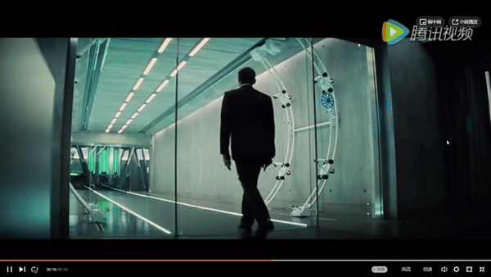

Slide 4
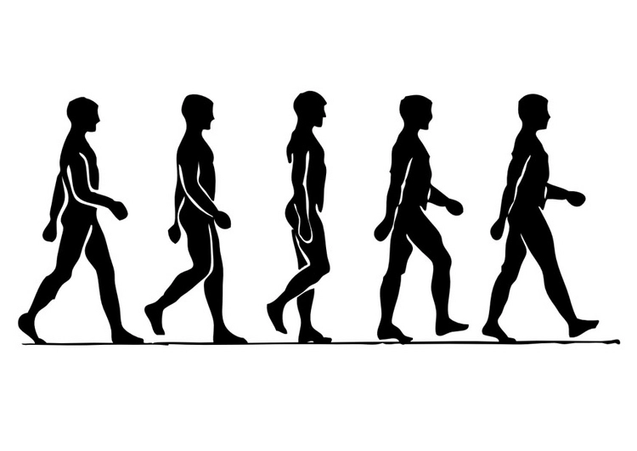
Idea
A new method of biometric authentication based on unique walking style of each individual.

Slide 5
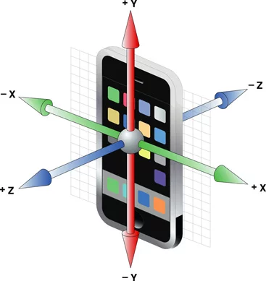
Motion Sensors
step counter sensor
linear acceleration sensor

Slide 6
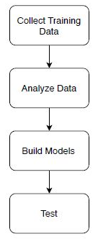
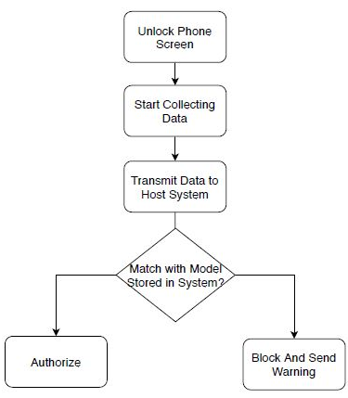
Approach Flow Chart
Figure 1. System Initialization
Figure 2. Authorization Process in Real Life

Slide 7
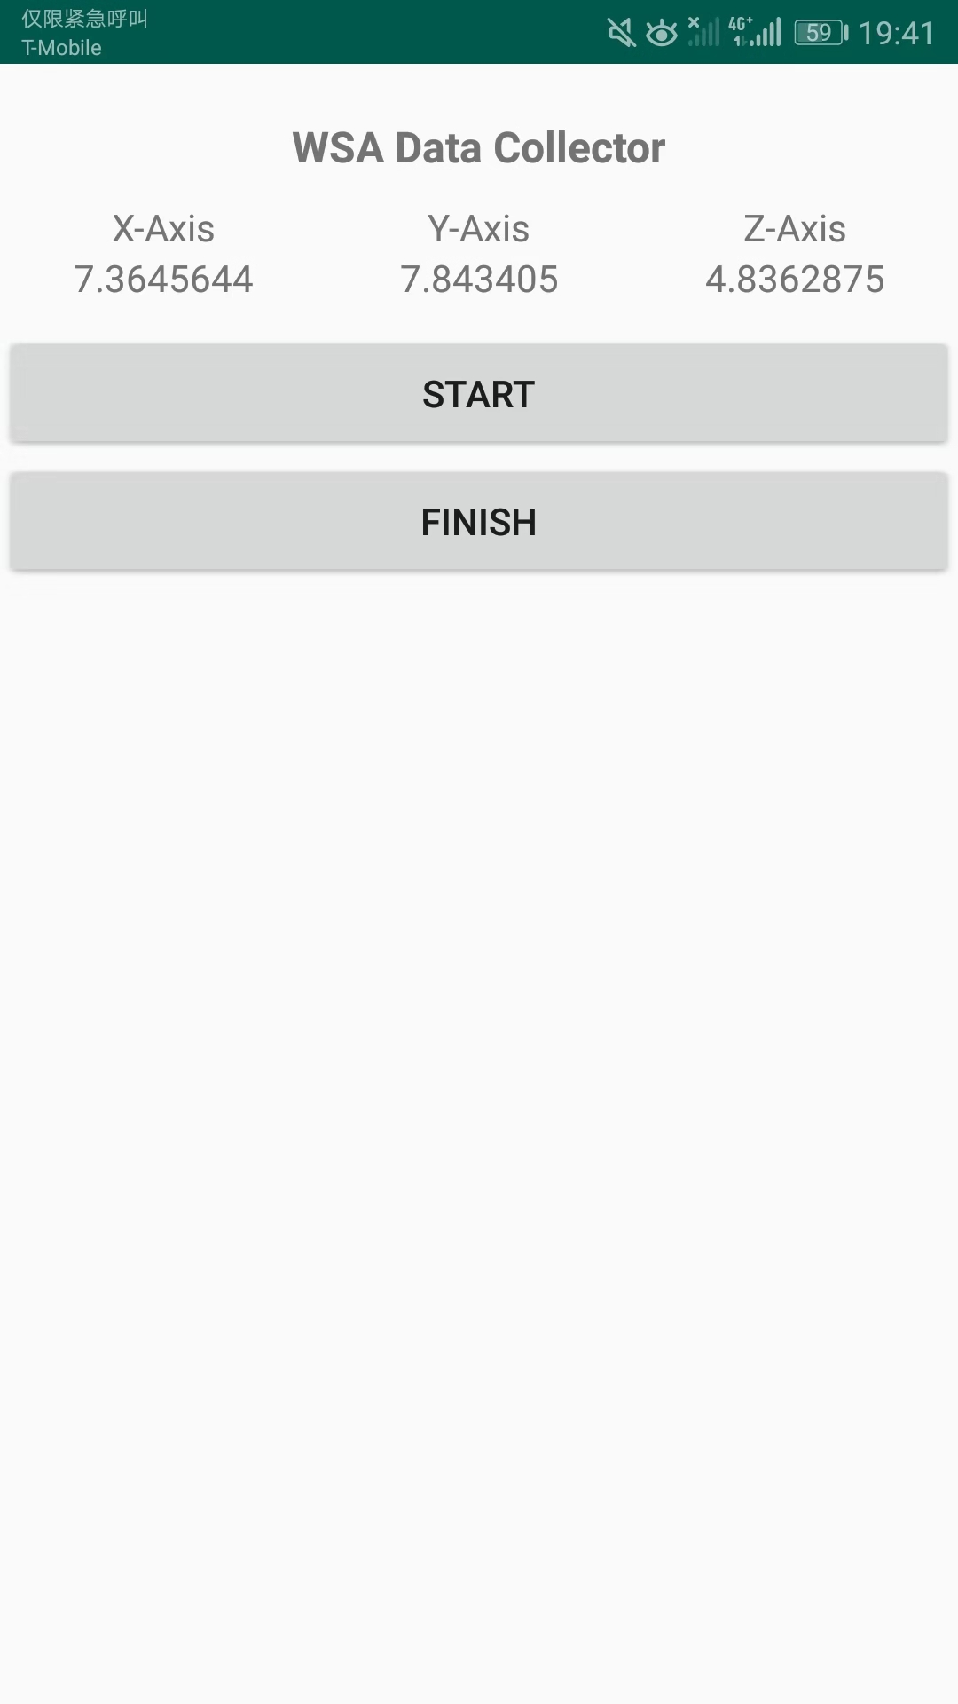
Approach - Data Collecting
Designed an android App using Android Studio to collect linear acceleration from x, y, and z three dimensions.
Save the output to the external storage on the phone.
Transmit data from phone to computer for future processing.

Slide 8
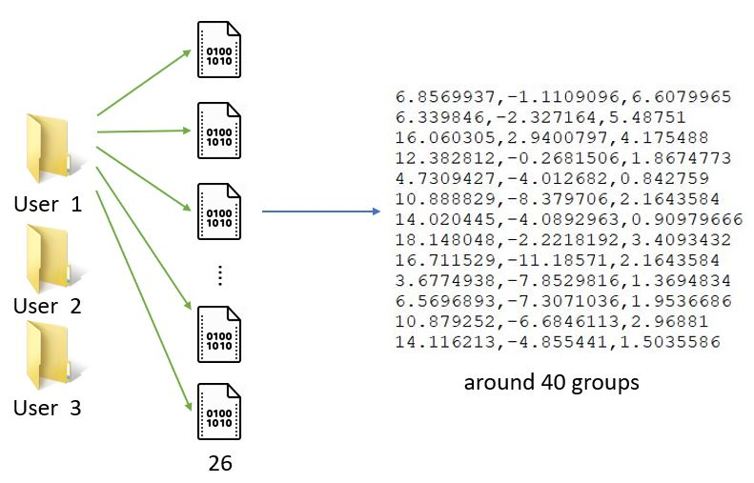
Approach - Data Collecting (cont’d)
Data collected from object walking within 10 meters.
Total: 3000 groups of data

Slide 9
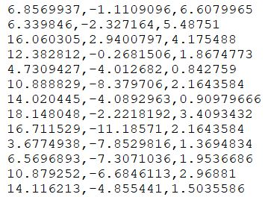
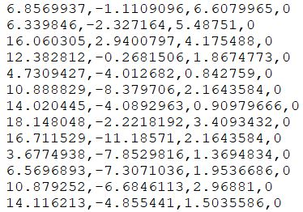
Approach - Data Processing
Wrote Python programs to integrate data and add labels to the data for future training and testing
Labelling for linear regression example:

Slide 10
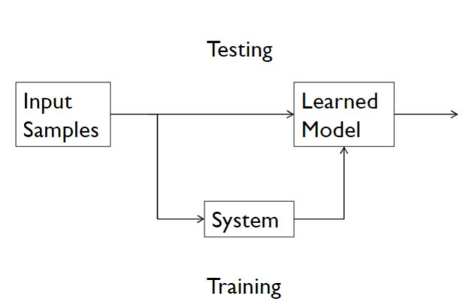
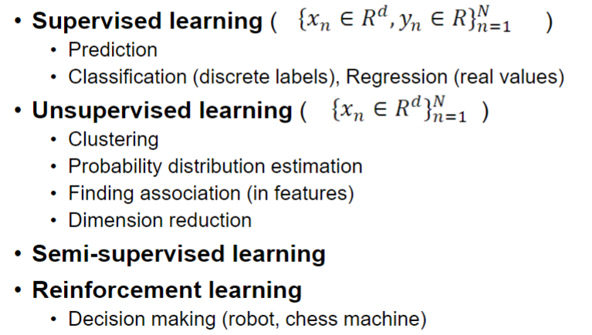
Approach - Related Works

Slide 11
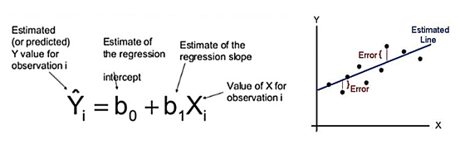
Approach - Linear Regression

Slide 12
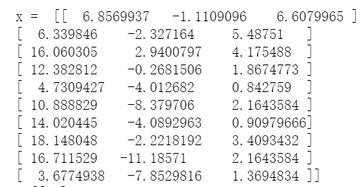
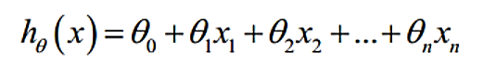
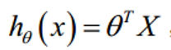
Approach - Linear Regression (Multiple Variables)

Slide 13
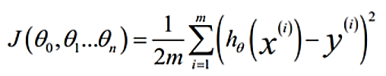
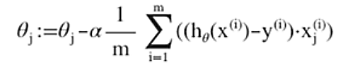
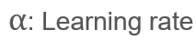
Approach - Linear Regression (Multiple Variables)
Cost Function (MSE):
Gradient Descent:

Slide 14
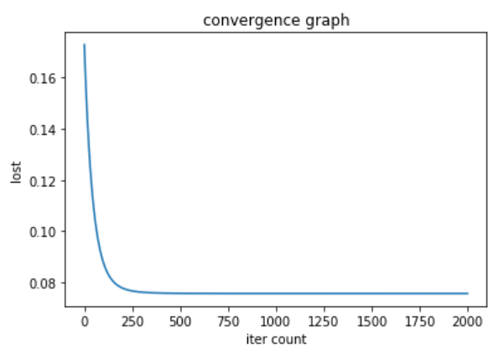
Approach - Linear Regression (Multiple Variables)
As the count of iterations increases, the lost decreases.
The accuracy is about 75%.

Slide 15
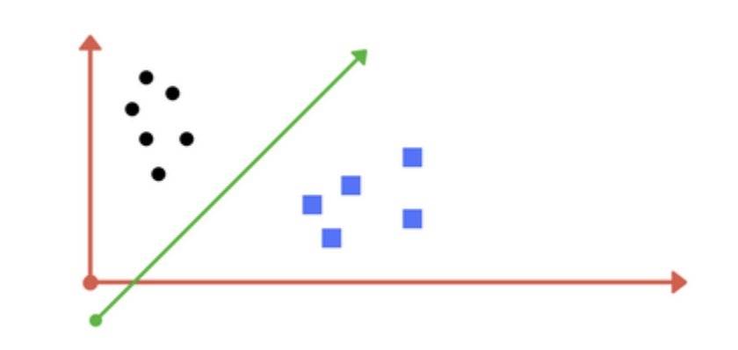
Approach - SVM (Cont’d)
Support Vector Machine (SVM)
SVM is a supervised learning algorithm. Given labeled training data, it would establish a learned model and discriminatively divide data into two parts.
Realization
With SVM, the accuracy of authentication has been calculated and plotted.

Slide 16
Approach - SVM (Cont’d)
Data processing
In the form of for each line.
Attach label 1 to people with authorization and label 0 to others.
Create four file.txt separately for label 0, label 1, data of label 0 and data of label 1.
Training and Testing
Set parameters for SVM and run with input.
Divide each file for training and testing with certain percentage. Then mix all the label files and mix all the data files.
Change the percentage of training data and testing data to obtain accuracy.

Slide 17
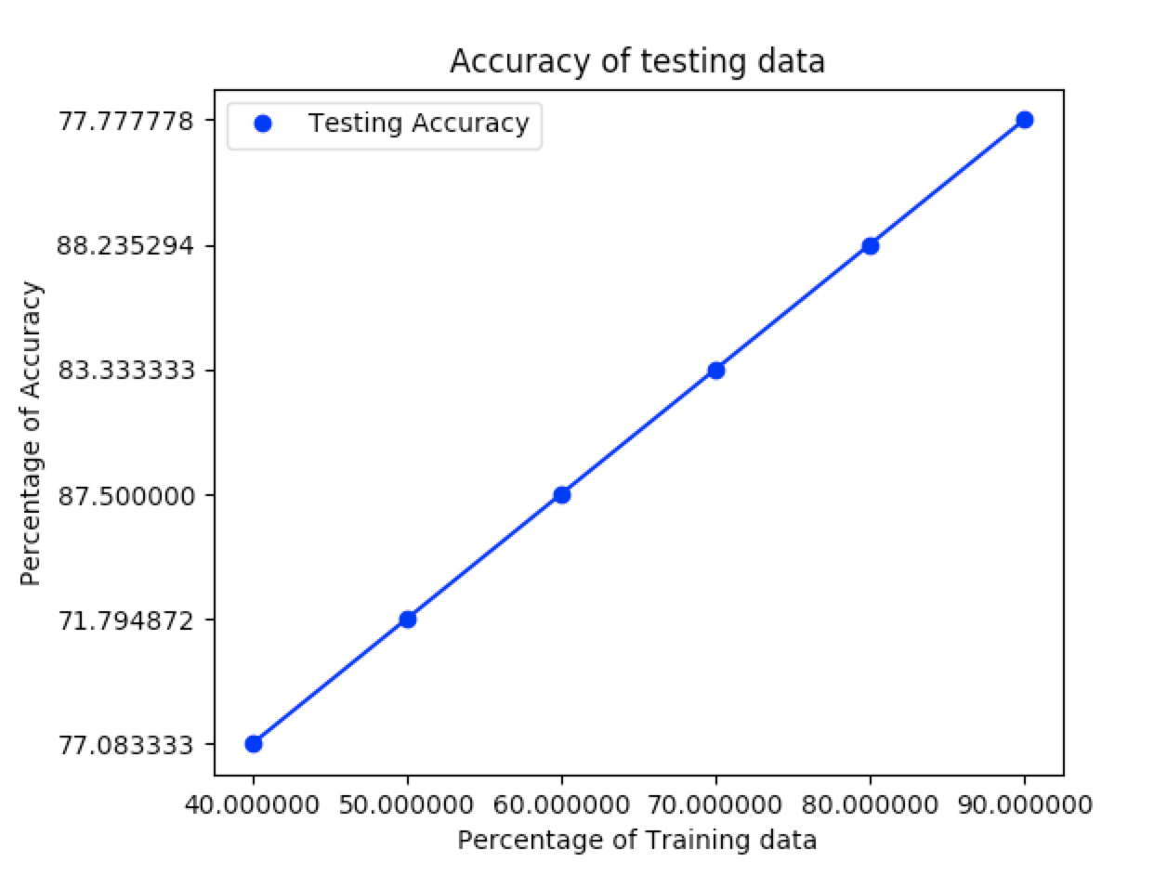
Approach - SVM (Cont’d)
Result:
Improve the accuracy of Linear Regression Algorithm, with 88.2% highest.

Slide 18
Future Works
Improve accuracy
Expand the amount of data for training
Try other algorithms
Transfer data
Design an APP which can realize that transferring data from android to system automatically once finishing recording

Slide 19
Questions?

Slide 20
Thank you！

